Slide 1

SCHOOL OF ELECTRICAL AND COMMUNICATION
DEPARTMENT OF ELECTRONICS AND COMMUNICATION ENGINEERING
1156EC701- MAJOR PROJECT
WINTER SEMESTER (2022-23)
VIVA VOCE
DESIGN AND DEVELOPEMENT OF AI DRIVEN E NOSE SYSTEM FOR QUALITY ANALYSIS IN APPLE
PRESENTED BY:
1. K.V.SASI KIRAN REDDY [VTU 11572] [19UEEC0272]
2. Y.MAHESWARAREDDY [VTU 11571] [19UEEC0645]
3. Y.V.SRI CHARAN REDDY [VTU 11823] [19UEEC0630]
SUPERVISOR
Dr. KANMANI RUBY E.D
Professor / ECE
1

Slide 2
ABSTRACT
The system will be developed using a dataset of images of apples, both fresh and Food spoilage is a significant problem in the food industry, causing significant economic losses and posing health risks to consumers. One common type of food spoilage is the decay of fresh fruits such as apples, which can be caused by a variety of factors, including microbial growth, physical damage, and exposure to oxygen. In this project, we propose the use of artificial intelligence (AI) to develop a system for the detection of fresh and rotten apples in the food industry. The system will use machine learning algorithms to analyse images of apples and classify them as fresh or rotten based on their visual appearanced rotten, that have been collected from different sources in the food industry. The model, which will learn to classify apples based on their visual features. After that depends on sensor based reading signals output decision will be taken.
KEYWORDS: Food Quality, Sensors, Contamination, Sensor.

Slide 3
OBJECTIVE
The proposed system should be able to detect the quality of fruits and provide an automated solution for food quality control and inspection
To design and develop an e-nose for analyzing the quality of apple with high accuracy.
To identify the sensors as per the chemical constituents present in the apple and design the sensor array of the e-nose system.
To design and develop an AI driven algorithm for predicting the quality of the apple for the processing system.

Slide 4
INTRODUCTION
Describing the data collection process, including the sample preparation, data acquisition, and pre-processing steps.
Data processing and analysis methods can be used, including the Python IDLE and Arduino IDE.
It can involve explaining how the raw data was processed and analyzed and the features were extracted from the data, which the models were trained and evaluated.
We can provide some results and analysis of the system’s performance.
This can include a discussion of the accuracy of the system in identifying the quality of the apple fruit samples tested, as well as a comparison with other existing methods for food quality analysis.
To eliminate the issue of finding of the Rotten Fruit and the Fresh Fruit the new system that the we are proposing the AI Driven E Nose System For Quality Analysis in Apple.

Slide 5
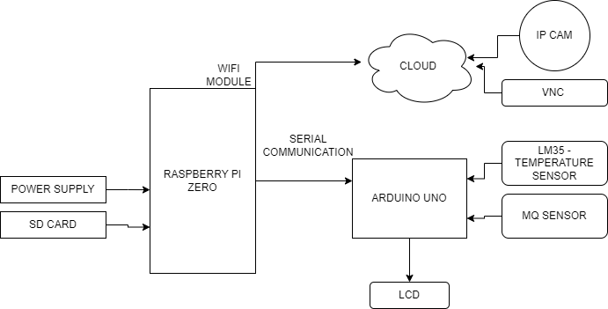
HARDWARE BLOCK DIAGRAM

Slide 6
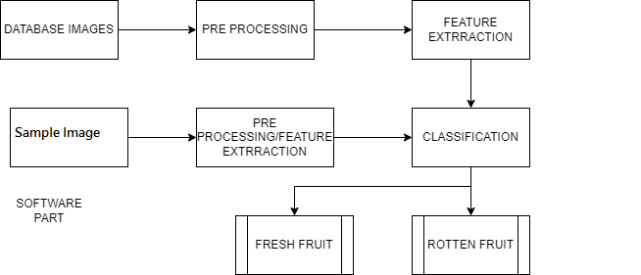
SOFTWARE BLOCK DIAGRAM

Slide 7
LITERATURE REVIEW
 | TITLE OF PAPER/JOURNAL | AUTHOR DETAILS | INFERENCE
1. | Development of a low-cost e-nose to assess aroma profiles: An artificial intelligence application to assess beer quality. | Viejo, C. G., Fuentes, S., Godbole, A., Widdicombe, B., & Unnithan, R. R. (2020). Development of a low-cost e-nose to assess aroma profiles: An artificial intelligence application to assess beer quality. Sensors and Actuators B: Chemical, 308, 127688. | The assessment of aromas in beer is critical to assess its quality since it could be used as an indicator of contamination or faults, which will directly influence consumers’ acceptability. Traditional techniques to evaluate aromas are time-consuming, require special training, costly equipment, and trained personnel. Therefore, this study aimed to develop a portable, low-cost electronic nose (e-nose) coupled with machine learning modeling to predict aromas in beer
2. | Recent developments of artificial intelligence in drying of fresh food. | Sun, Q., Zhang, M., & Mujumdar, A. S. (2019). Recent developments of artificial intelligence in drying of fresh food: A review. Critical reviews in food science and nutrition, 59(14), 2258-2275. | Intellectualization is an important direction of drying development and artificial intelligence (AI) technologies have been widely used to solve problems of nonlinear function approximation, pattern detection, data interpretation, optimization, simulation, diagnosis, control, data sorting, clustering, and noise reduction in different food drying technologies due to the advantages of self-learning ability, adaptive ability, strong fault tolerance and high degree robustness to map the nonlinear structures of arbitrarily complex and dynamic phenomena

Slide 8
LITERATURE REVIEW
 | TITLE OF PAPER/JOURNAL | AUTHOR DETAILS | INFERENCE
3. | Evaluation of an electronic nose to assess fruit ripeness | Brezmes, J., Fructuoso, M. L., Llobet, E., Vilanova, X., Recasens, I., Orts, J., ... & Correig, X. (2019). Evaluation of an electronic nose to assess fruit ripeness. IEEE Sensors Journal, 5(1), 97-108. | The main goal of our study was to see whether an artificial olfactory system can be used as a nondestructive instrument to measure fruit maturity. In order to make an objective comparison, samples measured with our electronic nose prototype were later characterized using fruit quality techniques. The cultivars chosen for the study were peaches, nectarines, apples, and pears. With peaches and nectarines, a PCA analysis on the electronic nose measurements helped to guess optimal harvest dates that were in good agreement with the ones obtained with fruit quality techniques.
4. | Electronic tongue and electronic nose for food quality and safety | Lu, L., Hu, Z., Hu, X., Li, D., & Tian, S. (2019). Electronic tongue and electronic nose for food quality and safety. Food Research International, 112214. | For the needs of food producers and consumers, electronic tongue and electronic nose play many roles for food quality and safety in food production, food supervision and daily life. The principles and progresses of electronic tongue and electronic nose were elaborated. The core hardware namely electronic tongue sensors and electronic nose sensors, and the core software namely intelligent sensory algorithms were summarized.

Slide 9
METHODOLOGY
Selecting sensors that can detect a wide range of volatile compounds that are specific to apples and calibrating them for optimal performance.
Sample collection and preparation: collecting apples from different stages of ripeness and preparing them for testing by removing any external contaminants.
Selection and calibration of appropriate sensors and designing sensor array.
Data acquisition and analysis: acquiring data from the sensors and analyzing it to determine the quality and ripeness of the apples.
Design of Deep learning algorithm for the processing unit to predict the quality of the apple.
Validation of the e-nose system: validating the e-nose system by comparing its results with those obtained from other testing methods.
Refining and improving the e-nose system: continuously refining and improving the e-nose system based on the results of validation and user feedback

Slide 10
WORKING MECHANISM
Collection of Temperature readings dataset from fresh and Ripen fruits with different set of apple which are wax coated .Here we can use both pre collected data or our own raw data. And then the preprocess the data by normalizing the temperature values and splitting it into training and testing sets. And then train a deep learning algorithm such as a convolutional neural network (CNN) on the training set to classify the fruits as fresh or ripe based on their temperature.Test the accuracy of the trained model on the testing set to evaluate its performance.However, manually checking each apple for freshness can be time-consuming and practically impossible. In this project, we propose an apple fruit image classification system using IP camera, Arduino microcontroller, and LCD displays for output. The system will use a convolutional neural network (CNN) to analyse apple images and classify them into fresh and spoiled categories. The system will consist of an IP camera that will capture images of apple.. The images will be processed by a system, which will send the processed data to an Arduino microcontroller through serial communication. The Arduino will then use the processed data to drive an LCD display, which will show whether the apple is fresh or spoiled. The system will be developed using a dataset of apple images, both fresh and spoiled, that have been collected different sources.

Slide 11
COMPONENTS REQUIRED
Raspberry Pi zero
1x Arduino
MQ Sensor
LM 35Sensor
I2C Lcd display
Jumper cables

Slide 12
SOFTWARE USED
Arduino IDE
Python IDLE
Google Colab
Roboflow For Annotation
YOLOv5

Slide 13
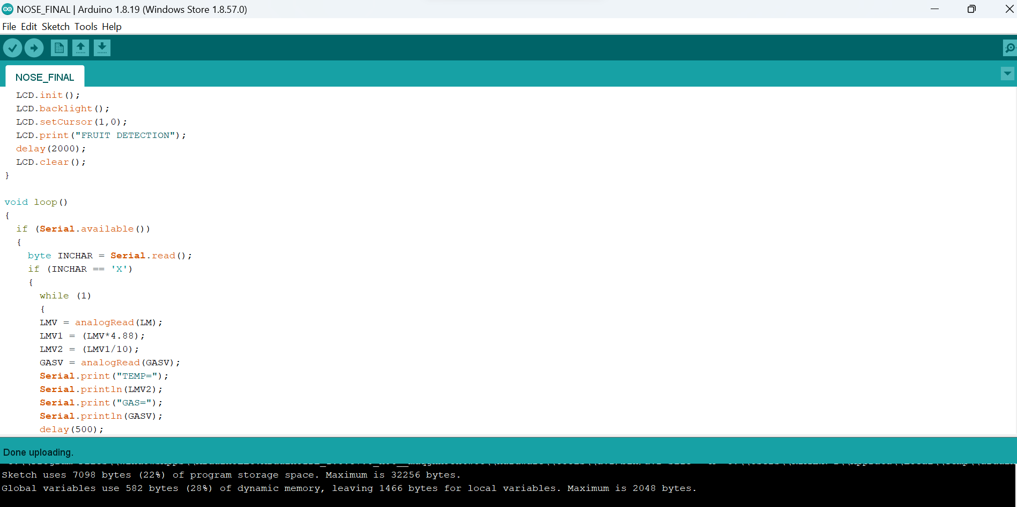
1.ARDUINO IDE

Slide 14
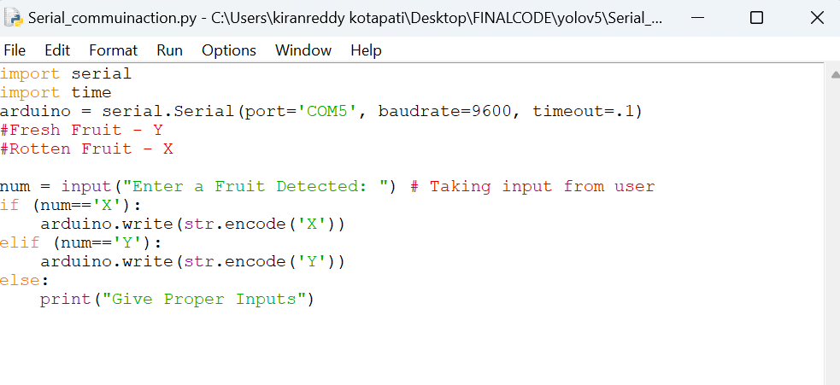
2.PYTHON IDLE

Slide 15
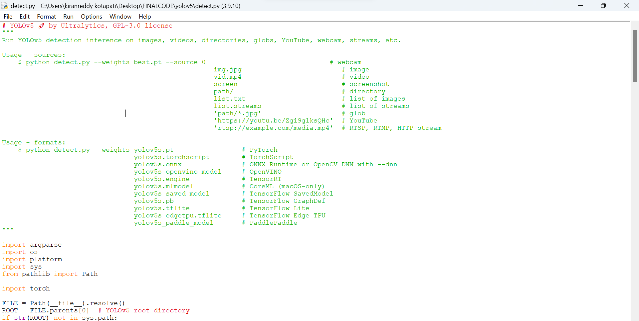
3.YOLOv5 ALGORITHM

Slide 16
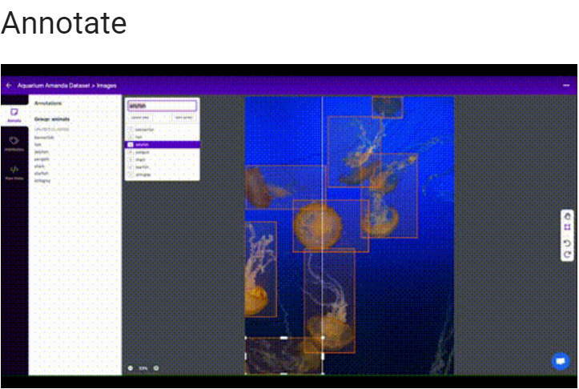
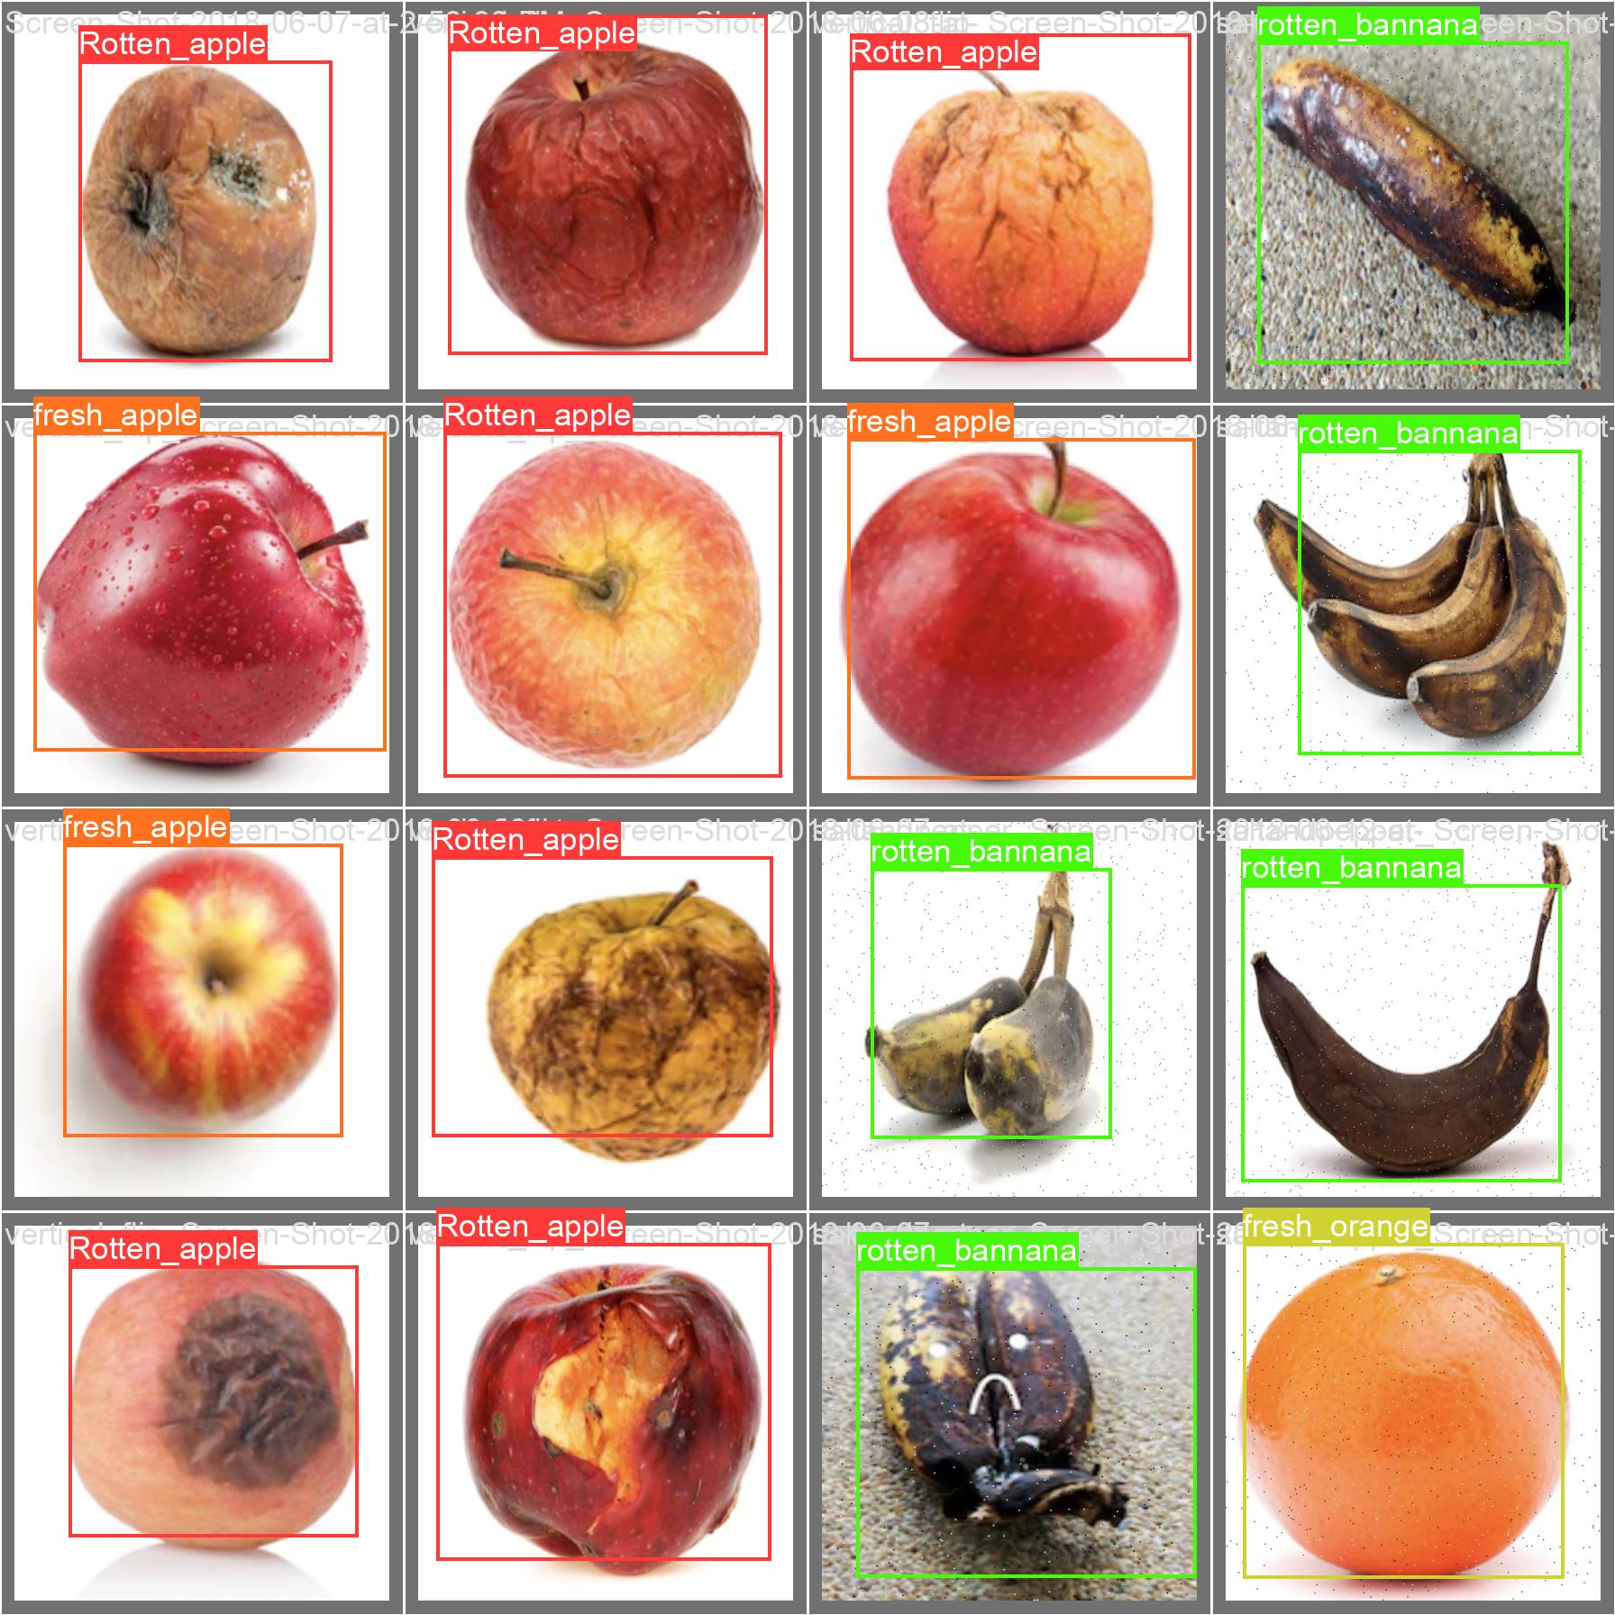
4.ROBOFLOW FOR ANNOTATION
4(a)
4(b)

Slide 17
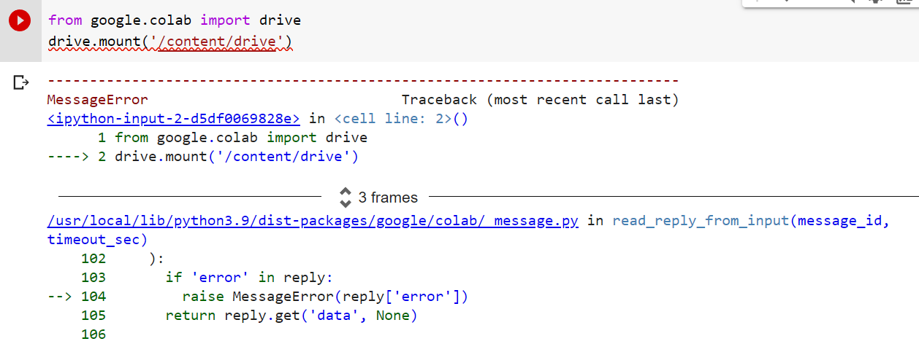
5.GOOGLE COLAB

Slide 18
IMPLEMENTATION
Firstly, it is needed to describe the overall approach you took in designing and developing the system, including the hardware and software components used This can include a detailed description of the e-nose device used, the sensors used to capture volatile organic compounds (VOCs) from the apple fruit, and the data processing.
Secondly, the data collection process, including the sample preparation, data acquisition, and pre-processing steps This can involve explaining how the e-nose device was calibrated and validated, and how the VOC data was collected and recorded.
Thirdly, the data processing and analysis methods used, including any machine learning or artificial intelligence algorithms used.
Fourthly, some results are provided and analysis of the system’s performance is done. This can include a discussion of the accuracy of the system in identifying the quality of the apple fruit samples tested, as well as a comparison with other existing methods for food quality analysis.
Finally, the key findings and highlighting the implications of the work are summarized for future research and development in this area.

Slide 19
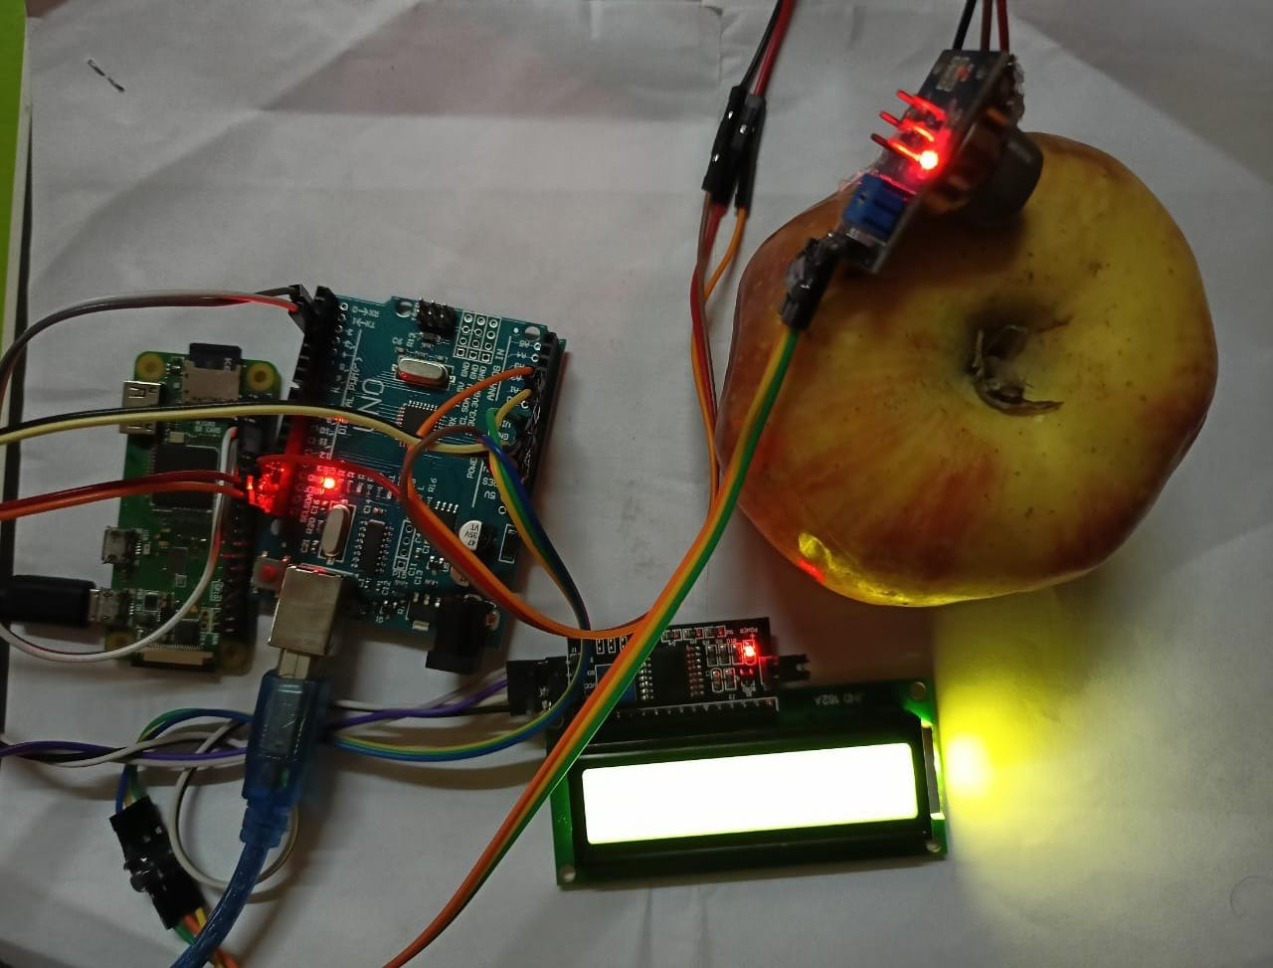
HARDWARE SETUP

Slide 20
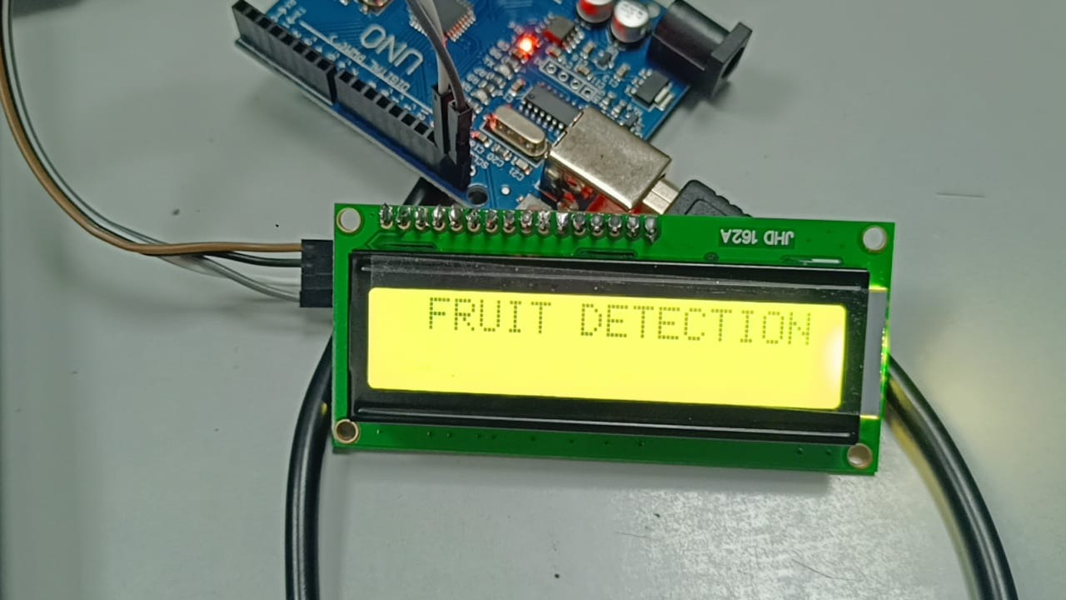
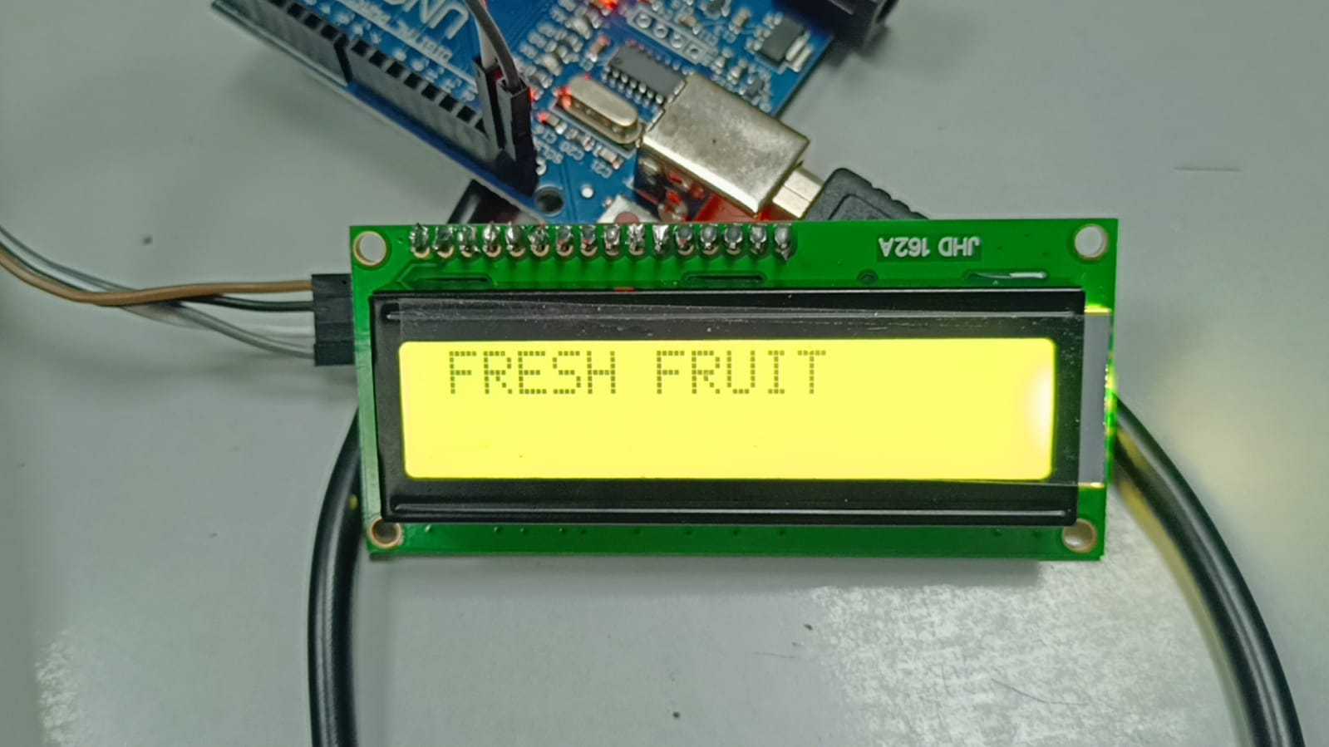
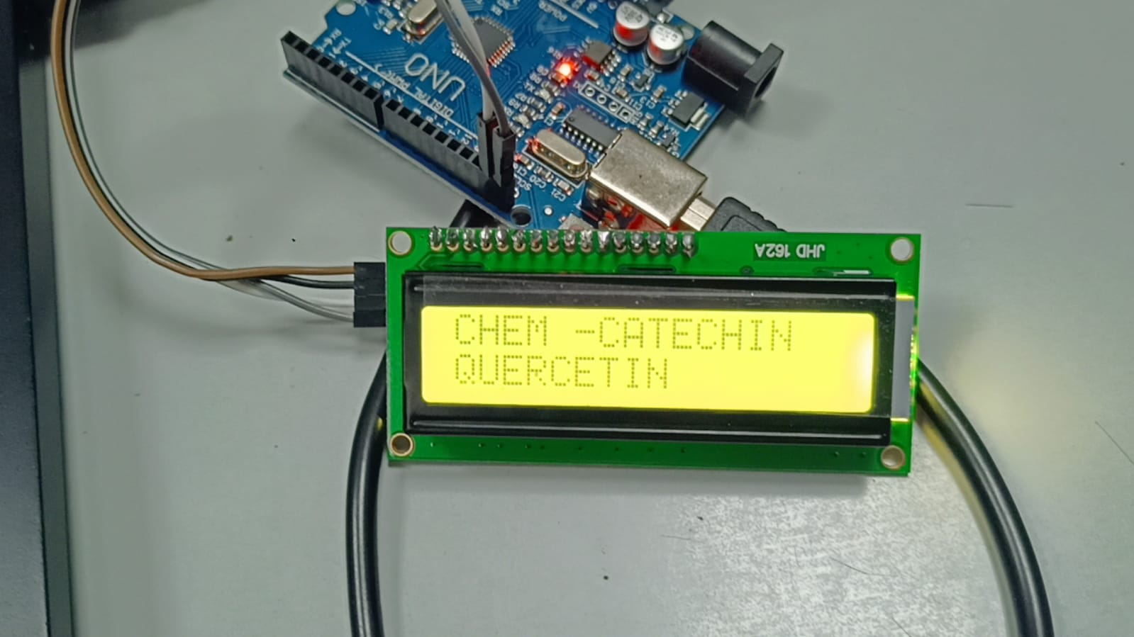
RESULTS Fresh Fruit detection:
Fig1: Fruit detection
Fig2: Fresh fruit detection
Fig3: Chemical detection

Slide 21
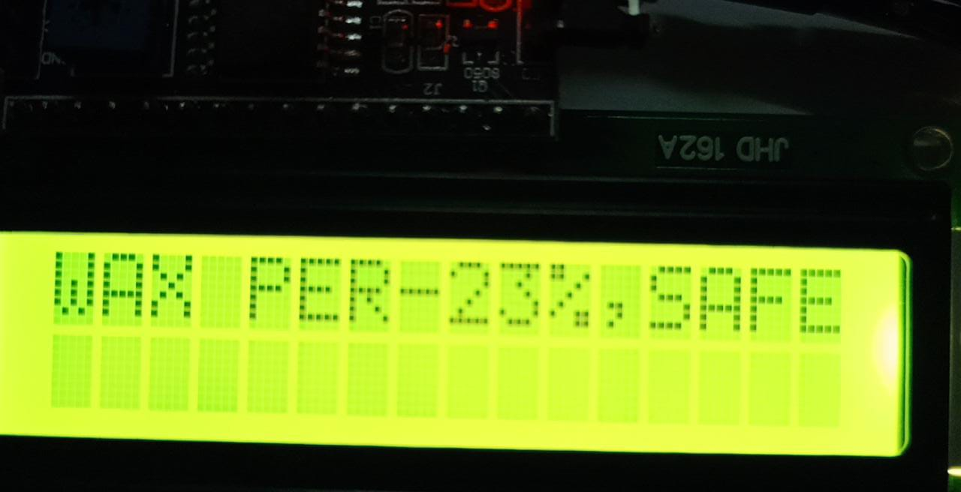
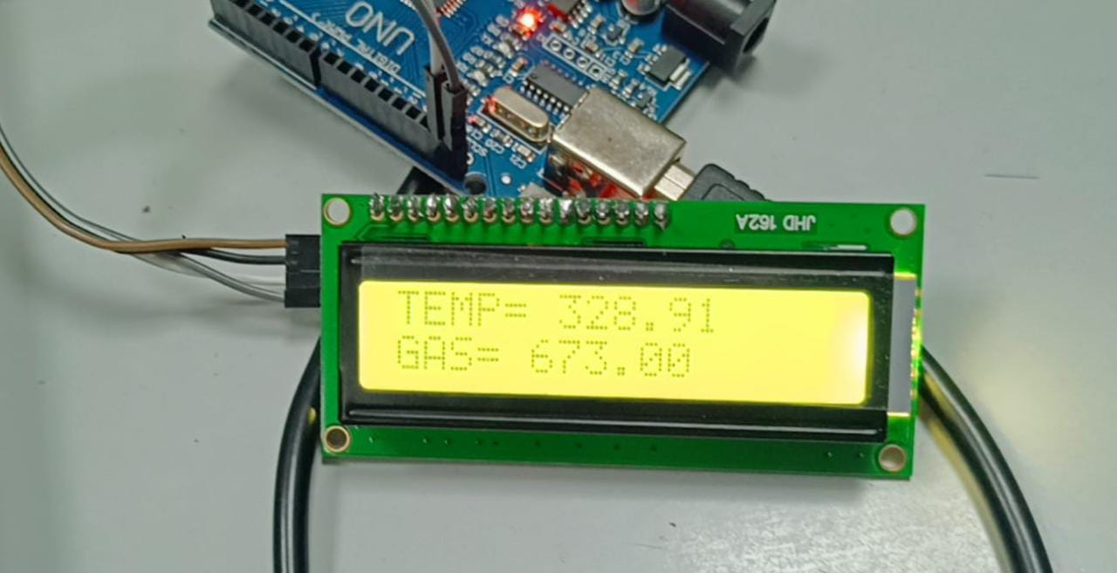
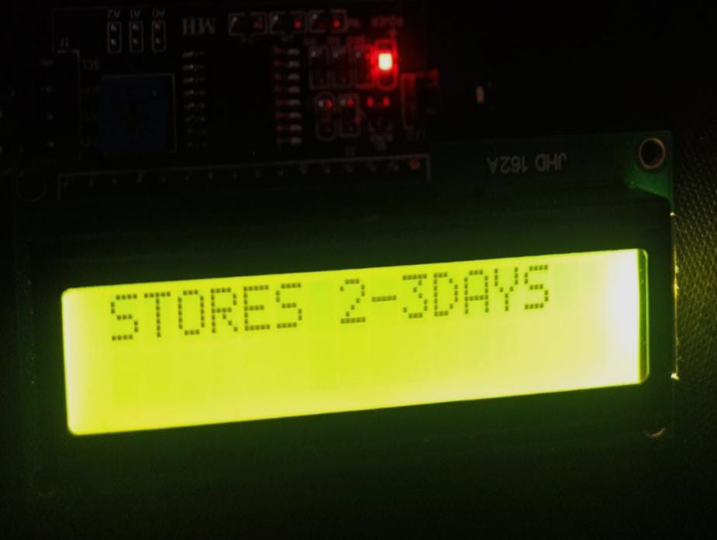
Fig4: wax detection
Fig5:Temperation and Gas detection
Fig6: Fresh fruit storage detection

Slide 22
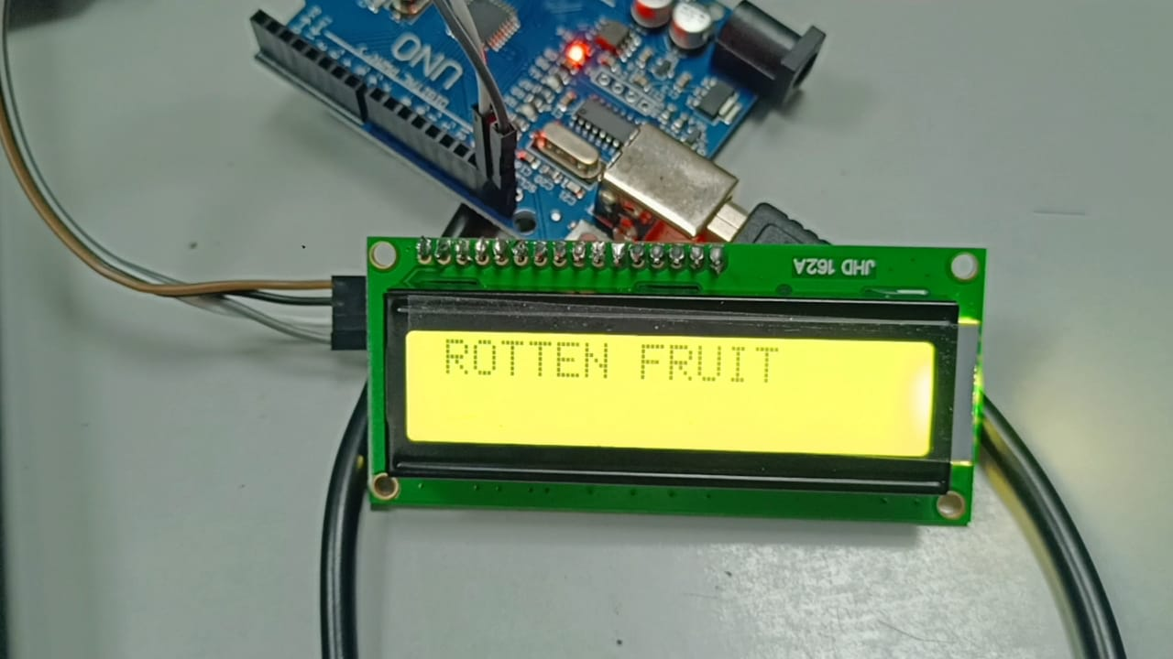
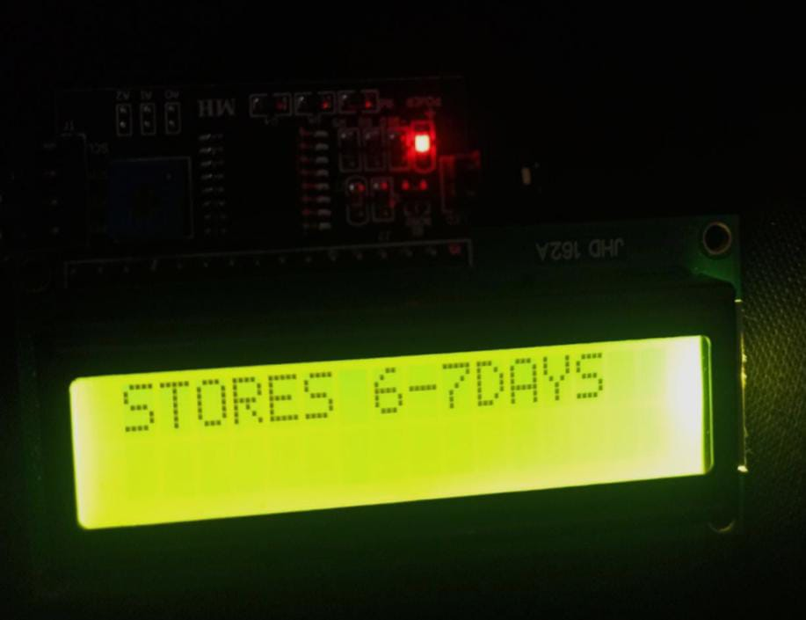
Rotten Fruit Detection:
Fig7: Fruit detection
Fig8: Rotten fruit detection
Fig9: Rotten fruit storage detection

Slide 23
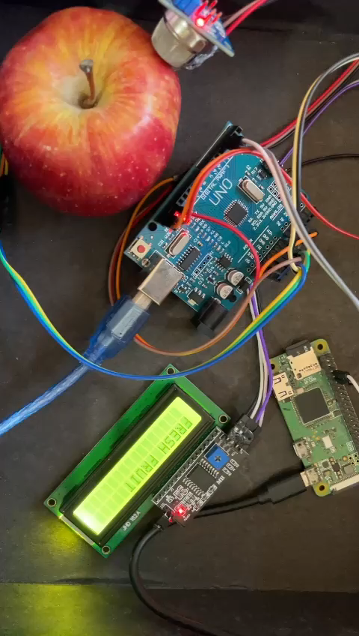
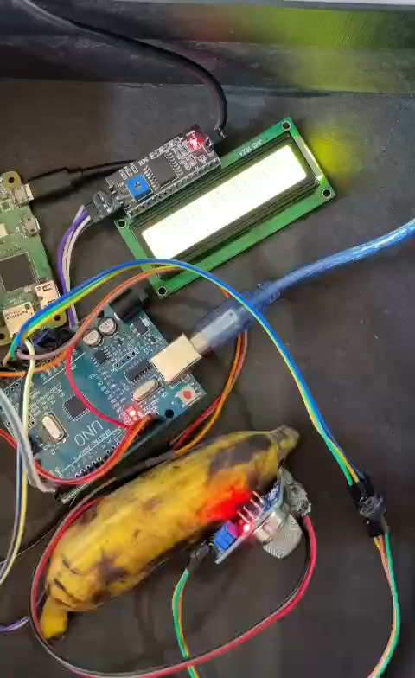
Result video format

Slide 24
TABLUATION
S.NO | FRUIT CONDITION | TEMPERATURE | WAX PERCENTAGE | STORES | CHEMICALS
1 | Unrotten | 72-78 F | 25 % below | 2-3 days | Quercetin, Catechin,Phloridzin, Chlorogenic
2 | Middle stage of rotten | 78-85 F | 26-40 % | 4-5 days | Galactose, Arabinose
3 | rotten | 85-94 F | 40-70 % | 6-7days | Penicillium, Aspergilllus

Slide 25
CONCLUSION
This project aimed to develop a system for detecting the freshness and ripeness of fruits based on their temperature using an LM35 sensor and a deep learning algorithm.
Additionally, the proposed system aimed to classify fruits as organic or non-organic based on the readings obtained from an MQ sensor.
The results of this project showed that the proposed method can accurately detect the quality of fruits, providing an automated solution for food quality control and inspection.
The proposed system can potentially contribute to reducing food waste and improving the quality of food products in the food industry.

Slide 26
PROJECT TIME PLAN
S.NO | PROJECT ACTIVITY | DESCRIPTION | DATE OF COMPLETION
1 | Topic Review | Methodology of the project | 21/01/2023
2 | Literature survey | The Survey on the project title from journal papers | 25/01/2023
3 | Review with Supervisor | Concept Discussion | 01/02/2023
4 | Basic methodology | How system works | 15/02/2023
5 | Methodology Implementation | Implementation of Proposed scheme | 25/02/2023
6 | Software implementation | Implementation of code | 20/03/2023
7 | Trial Run | Checking the result of the project | 02/04/2023

Slide 27
REFERENCES
RajatabhAgarwal, Boominathan P,” Vehicle Security System Using IoT Application” , IRJET, Volume 05, Issue 04, Apr-2018.
A. Z. Loko, A. I. Bugaje, Usman Abdullahi,” Microcontroller Based Smart Card Car Security System” , International Journal of Engineering Trends and Technology, Volume 29, NO 3 November 2015.
Priti K Powale, G. N, Zade,” Real time car antitheft system with accident detection using AVR microcontroller” , international journal of advance research in computer science and management studies, Volume 2, Issue 1, January 2014.
Mr. Raj Rai, Prof. Dinesh Katole, Miss. Nayan Rai,” Survey paper on vehicle theft detection through face recognition system” , international journal of emerging trends technology in computer science (IJETICS), Volume 3, Issue 1, January - February 2014.
C Saikrishna Prasad*, U. Sravan Kumar M.Tech, Dr.M.Narsing Yad av M.S., PhD (U.S.A), ” Advanced Authentication and Security system In Vehicles” , IJESMR,January 2016.

Slide 28
THANK YOU

